Slide 1
Lab 4 Fourier Transform

Slide 2
Objective
From Fourier series to Fourier transform.
Analyze the signals with Fourier Transform.
Analyze the LTI system with system models.

Slide 3

Relationship
The interval of spectrum line:
$$ω_{1}=\frac{2π}{T_{1}}$$
Main lobe width:
$$\frac{2π}{τ}$$
Amplitude:
$$\frac{Eτ}{T}$$

Slide 4
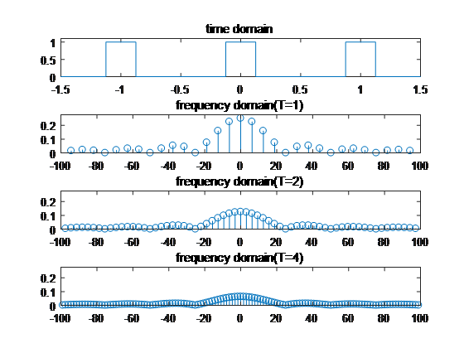

The Influence of T
The interval of spectrum line:
$$ω_{1}=\frac{2π}{T_{1}}$$
Main lobe width:
$$\frac{2π}{τ}$$
Amplitude:
$$\frac{Eτ}{T}$$

Slide 5
Fourier Series and Fourier Transform

Slide 6
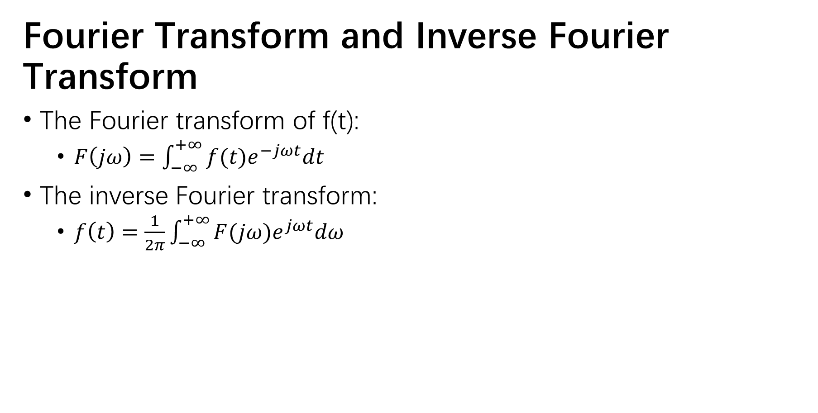

Fourier Transform and Inverse Fourier Transform
The Fourier transform of f(t):
$F\left(jω\right)=\int_{−∞}^{+∞}{f(t)e^{−jωt}dt}$
The inverse Fourier transform:
$f\left(t\right)=\frac{1}{2π}\int_{−∞}^{+∞}{F(jω)e^{jωt}dω}$
Complex exponential Fourier series
$F_{n}=\frac{1}{T_{1}}\int_{t_{0}}^{t_{0}+T_{1}}{f(t)e^{−jnω_{1}t}dt}$
$f\left(t\right)=\sum_{n=−∞}^{∞}{F_{n}e^{jnω_{1}t}}$

Slide 7
Fourier Transform with Matlab
Symbolic method
Function:fourier/ifourier
Fourier Transform
Function:fft
Numeric method
Direct method
Signal Analyzer

Slide 8
e.g.
Symbolic Method
Fourier transform:
F = fourier(f)
F = fourier(f,v)
F = fourier(f,u,v)
Inverse Fourier transform:
f = ifourier(F)
f = ifourier(F,u)
f = ifourier(F,v,u)
Use function abs and angle to plot the amplitude-frequency and phase-frequency

Slide 9
Numeric Method
Fourier transform:
Y = fft(x)
Y = fft(x,n)
Inverse Fourier transform
x = ifft(Y)
x = ifft(Y,n)

Slide 10
Numeric Method
x=
cos(2*pi*10.*t)+
2sin(2*pi*15.*t)+
3cos(2*pi*20.*t)

Slide 11
Numeric Method
x=cos(2*pi*10.*t)+2sin(2*pi*15.*t)+3cos(2*pi*20.*t)
N = 256;
Fs = 100;
t = [0:N-1]./Fs;
x=1*cos(2*pi*10.*t)+2*sin(2*pi*15.*t)+3*cos(2*pi*20.*t);
Y = fft(x,N);
plot(abs(Y))
Amplitude | Frequency
1 | 10
2 | 15
3 | 20
ts = 0.01; Fs = 1/ts
N = 256;
t = 0:ts: (N-1)*ts;

Slide 12
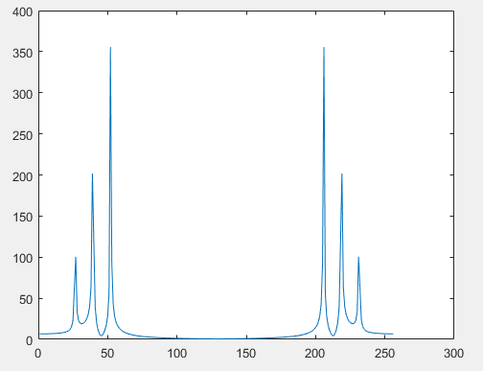
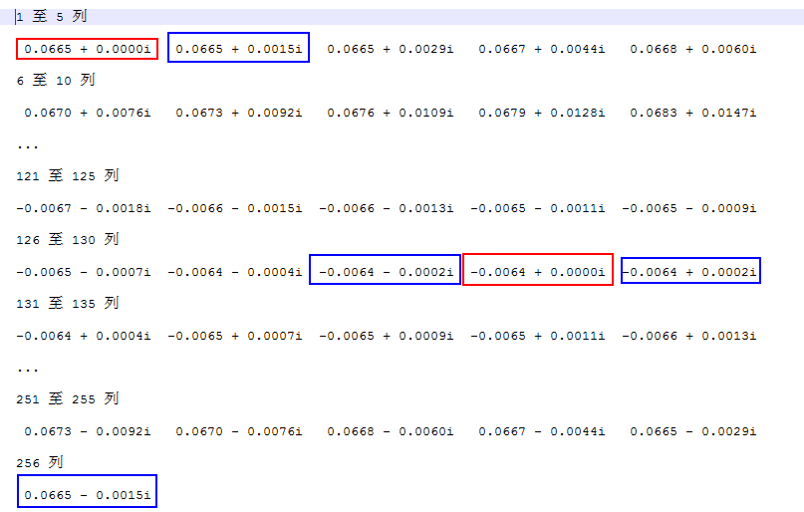
Numeric Method

Slide 13
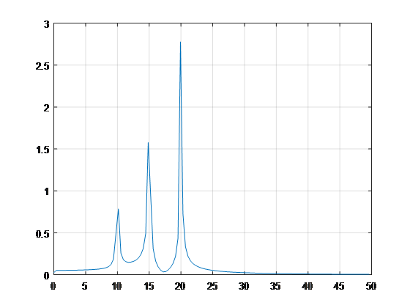
Numeric Method
N = 256;
Fs = 100;
df = Fs/N;
f = [0:N-1]*df;
t = [0:N-1]./Fs;
x=1*cos(2*pi*10.*t)
+2*sin(2*pi*15.*t+deg2rad(30))
+3*cos(2*pi*20.*t+deg2rad(-30));
Y = fft(x);
Yabs = abs(X);
Yabs = 2*Yabs/N;
Yabs(1) = Yabs(1)/2;
Yabs = Yabs(1:N/2);
f = f(1:N/2);
plot(f,Yabs)

Slide 14
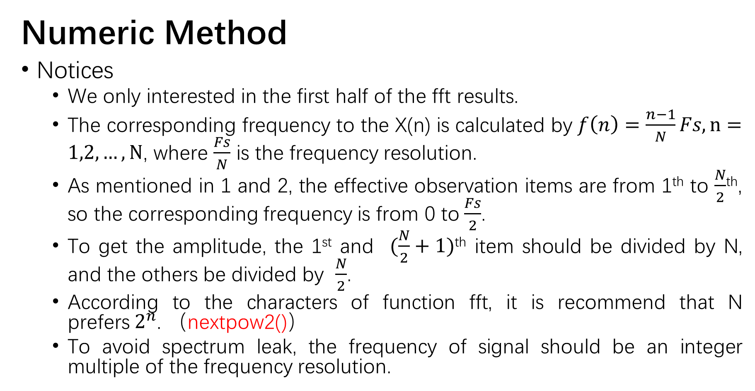
Numeric Method
Notices
We only interested in the first half of the fft results.
The corresponding frequency to the X(n) is calculated by $f\left(n\right)=\frac{n−1}{N}Fs, n=1,2,…,N$, where $\frac{Fs}{N}$ is the frequency resolution.
As mentioned in 1 and 2, the effective observation items are from 1th to $\frac{N}{2}$^{th}, so the corresponding frequency is from 0 to$\frac{Fs}{2}$.
To get the amplitude, the 1st and $(\frac{N}{2}+1)$^{th} item should be divided by N, and the others be divided by $\frac{N}{2}$.
According to the characters of function fft, it is recommend that N prefers$2^{n}$. （nextpow2()）
To avoid spectrum leak, the frequency of signal should be an integer multiple of the frequency resolution.

Slide 15
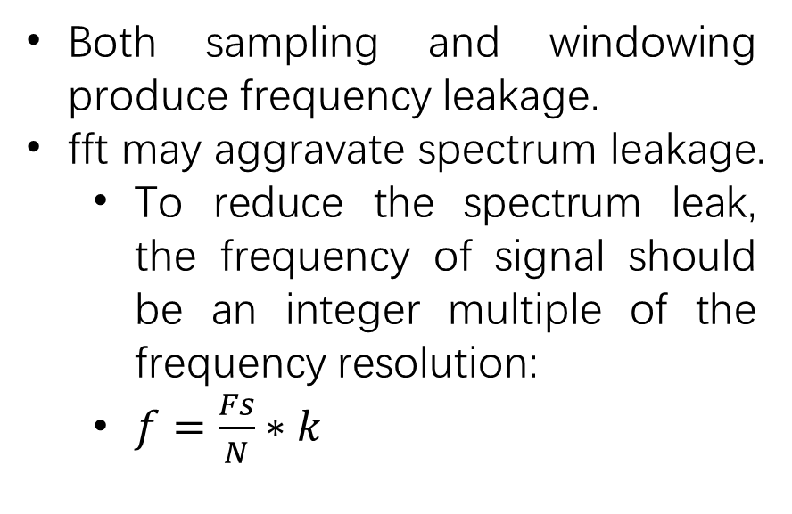
Frequency Leakage
Both sampling and windowing produce frequency leakage.
fft may aggravate spectrum leakage.
To reduce the spectrum leak, the frequency of signal should be an integer multiple of the frequency resolution:
$f=\frac{Fs}{N}∗k$

Slide 16
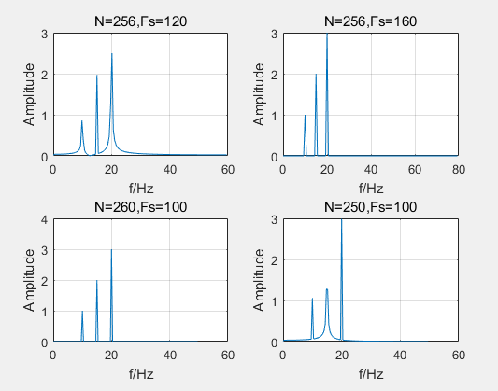
Frequency Leakage
K=f*N/Fs, N=256
 | f=10Hz, Amp=1 | f=15Hz, Amp=2 | f=20Hz, Amp=3
Fs=120Hz | k=21.33 | k=32 | k=42.7
Fs=160Hz | k=16 | k=24 | k=32
K=f*N/Fs, Fs=100Hz
 | f=10Hz, Amp=1 | f=15Hz, Amp=2 | f=20Hz, Amp=3
N=260 | k=26 | k=39 | k=52
N=250 | k=25 | k=37.5 | k=50

Slide 17
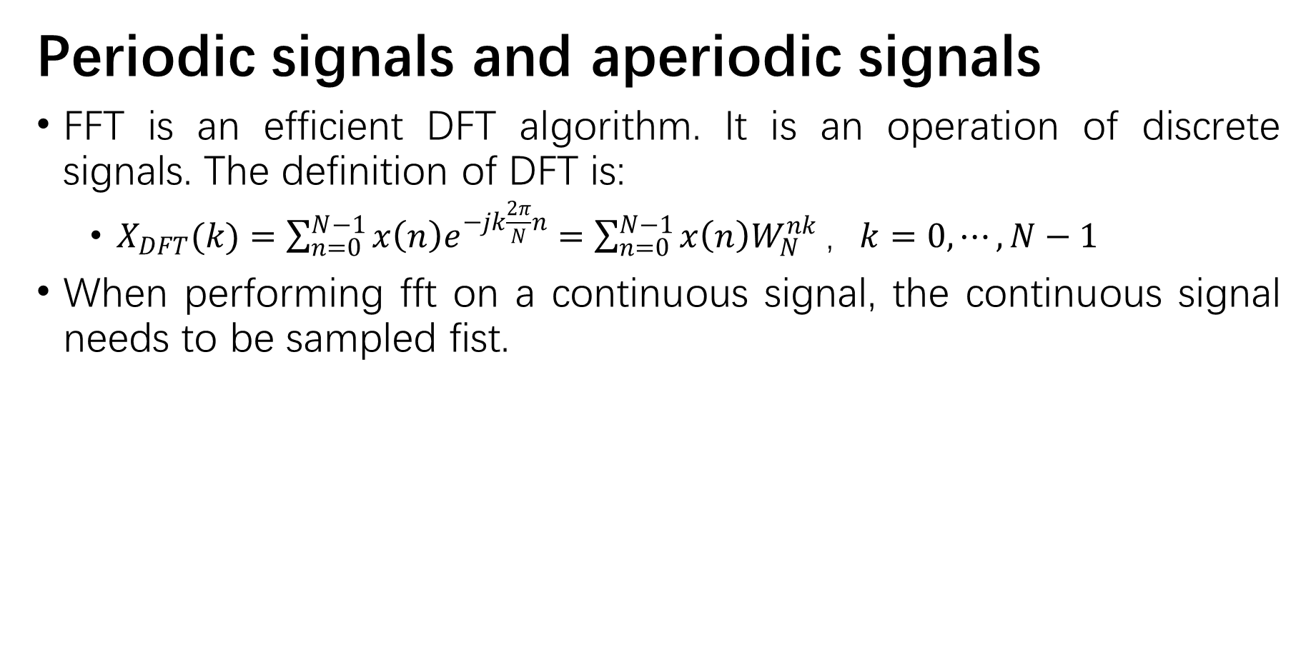
Periodic signals and aperiodic signals
FFT is an efficient DFT algorithm. It is an operation of discrete signals. The definition of DFT is:
$X_{DFT}(k)=\sum_{n=0}^{N−1}{x\left(n\right)e^{−jk\frac{2π}{N}n}}=\sum_{n=0}^{N−1}{x\left(n\right)W_{N}^{nk}}，k=0,⋯,N−1$
When performing fft on a continuous signal, the continuous signal needs to be sampled fist.

Slide 18
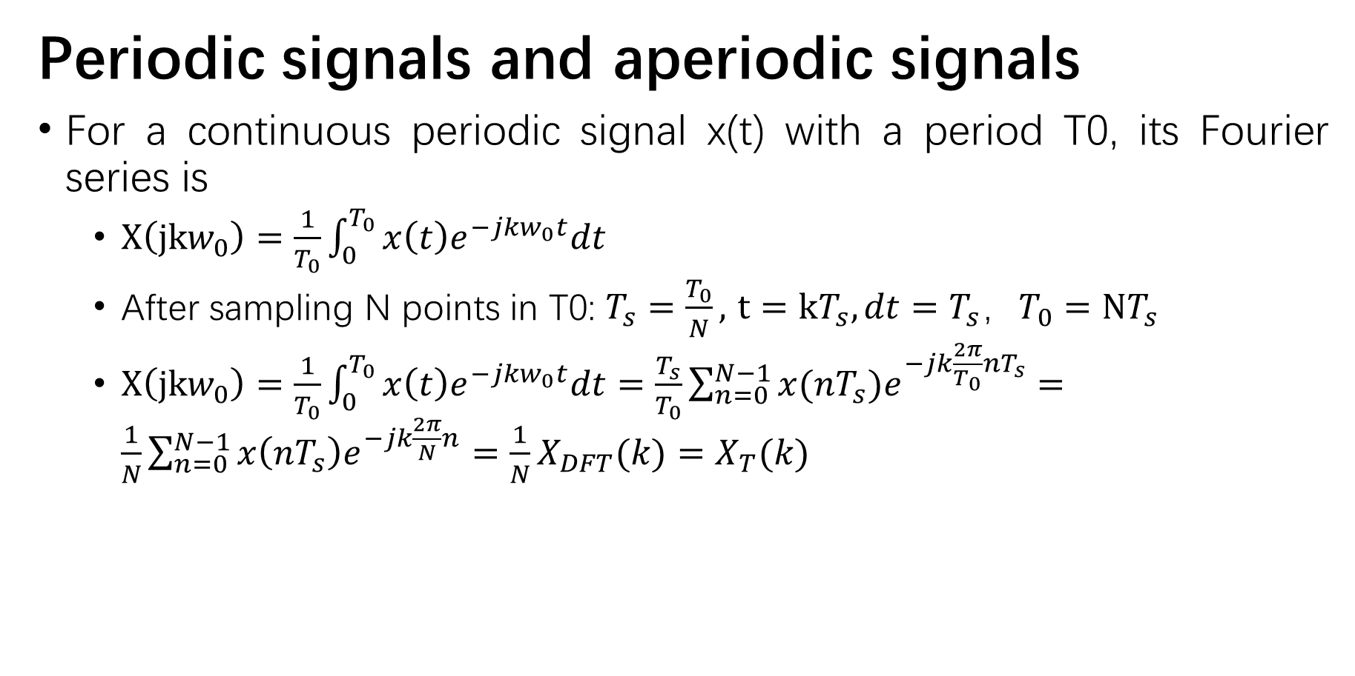
Periodic signals and aperiodic signals
For a continuous periodic signal x(t) with a period T0, its Fourier series is
$X\left(jkw_{0}\right)=\frac{1}{T_{0}}\int_{0}^{T_{0}}{x\left(t\right)e^{−jkw_{0}t}dt}$
After sampling N points in T0: $T_{s}=\frac{T_{0}}{N},$ $t=kT_{s}, dt=T_{s}，T_{0}=NT_{s}$
$X\left(jkw_{0}\right)=\frac{1}{T_{0}}\int_{0}^{T_{0}}{x\left(t\right)e^{−jkw_{0}t}dt}=\frac{T_{s}}{T_{0}}\sum_{n=0}^{N−1}{x(nT_{s})e^{−jk\frac{2π}{T_{0}}nT_{s}}}=\frac{1}{N}\sum_{n=0}^{N−1}{x\left(nT_{s}\right)e^{−jk\frac{2π}{N}n}}=\frac{1}{N}X_{DFT}(k)=X_{T}(k)$

Slide 19
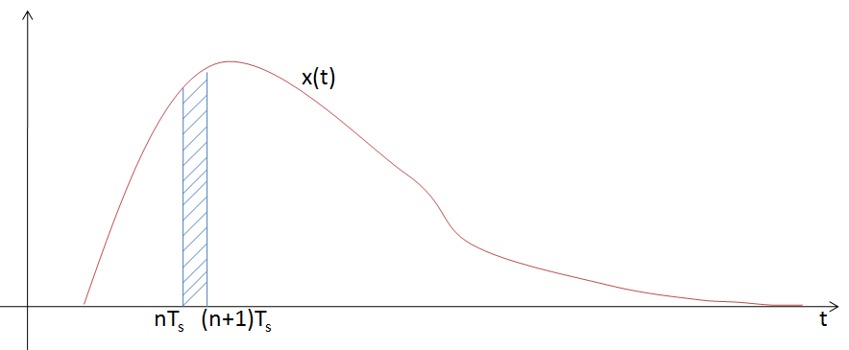


Periodic signals and aperiodic signals
For a continuous aperiodic signal x(t), its Fourier transform is
$X\left(jw\right)=\int_{−∞}^{+∞}{x(t)e^{−jwt}dt}$
After sampling:
$$X\left(jw\right)=\int_{−∞}^{+∞}{x(t)e^{−jwt}dt}=\sum_{n=0}^{N−1}{\int_{nT_{s}}^{(n+1)T_{s}}{x(t)e^{−jwt}dt}}=\sum_{n=0}^{N−1}{T_{s}∙\frac{1}{T_{s}}\int_{nT_{s}}^{(n+1)T_{s}}{x(t)e^{−jwt}dt}}=T_{s}∙X_{T}\left(k\right)，T_{0}=T_{s}$$

Slide 20

e.g.
Direct Fourier Transform
$F\left(jω\right)=\int_{−∞}^{+∞}{f(t)e^{−jωt}}dt=\lim_{τ→0}{\sum_{n=−∞}^{∞}{f(nτ)e^{−jwnτ}τ}}，−N≤n≤N$
$F\left(ω_{k}\right)=τ\sum_{n=−N}^{N}{f(nτ)e^{−jω_{k}nτ}}, −M≤k≤M$
$f_{s}=\frac{1}{τ}$
$ω_{k}=\frac{2πf_{s}}{M}k=\frac{2π}{Mτ}k$
Expressed in the matrix:

Slide 21
e.g.
Signal Analyzer APP
APP->Signal Analyzer

Slide 22
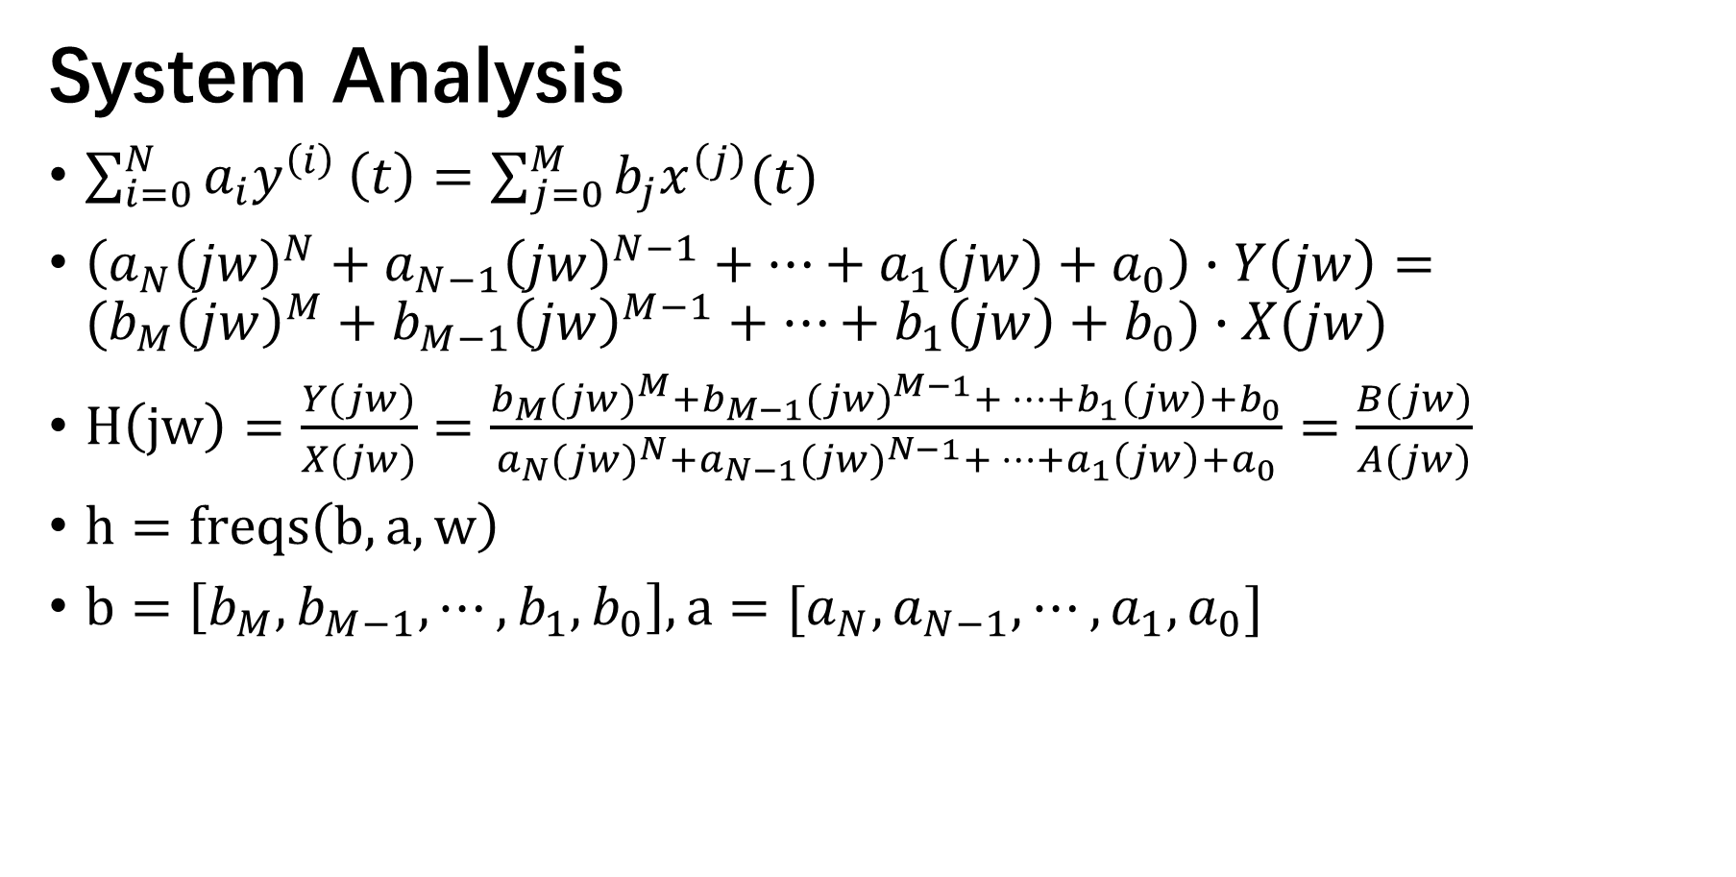
e.g.
System Analysis
$\sum_{i=0}^{N}{a_{i}y^{\left(i\right)}}\left(t\right)=\sum_{j=0}^{M}{b_{j}x^{\left(j\right)}(t)}$
$\left(a_{N}{\left(jw\right)}^{N}+a_{N−1}{\left(jw\right)}^{N−1}+⋯+a_{1}\left(jw\right)+a_{0}\right)∙Y\left(jw\right)=(b_{M}{\left(jw\right)}^{M}+b_{M−1}{\left(jw\right)}^{M−1}+⋯+b_{1}\left(jw\right)+b_{0})∙X(jw)$
$H\left(jw\right)=\frac{Y(jw)}{X(jw)}=\frac{b_{M}{(jw)}^{M}+b_{M−1}{(jw)}^{M−1}+⋯+b_{1}\left(jw\right)+b_{0}}{a_{N}{(jw)}^{N}+a_{N−1}{(jw)}^{N−1}+⋯+a_{1}\left(jw\right)+a_{0}}=\frac{B(jw)}{A(jw)}$
$h=freqs\left(b,a,w\right)$
$b=\left[b_{M},b_{M−1},⋯,b_{1},b_{0}\right], a=[a_{N},a_{N−1},⋯,a_{1},a_{0}]$

